Slide 1
SmartCar Entry
EC500 J1 Project proposal
-Alex-

Slide 2






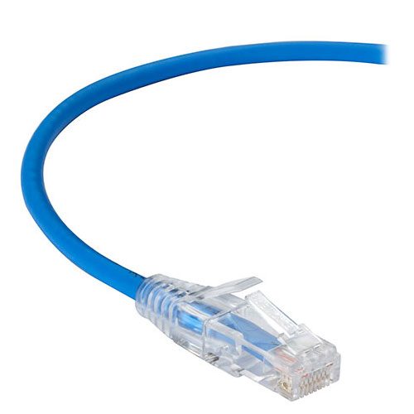
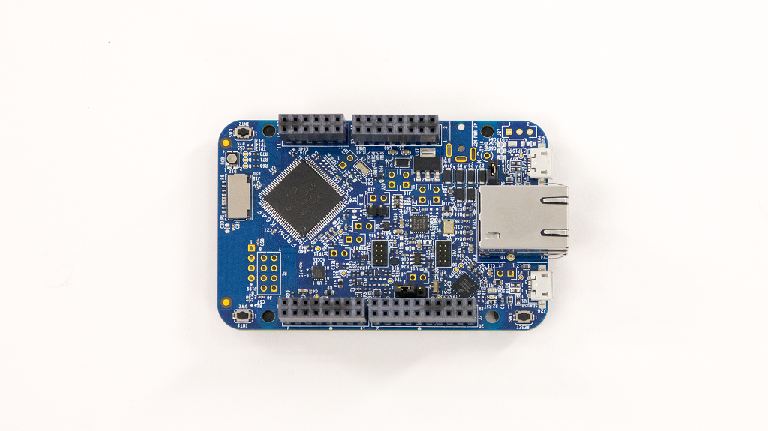
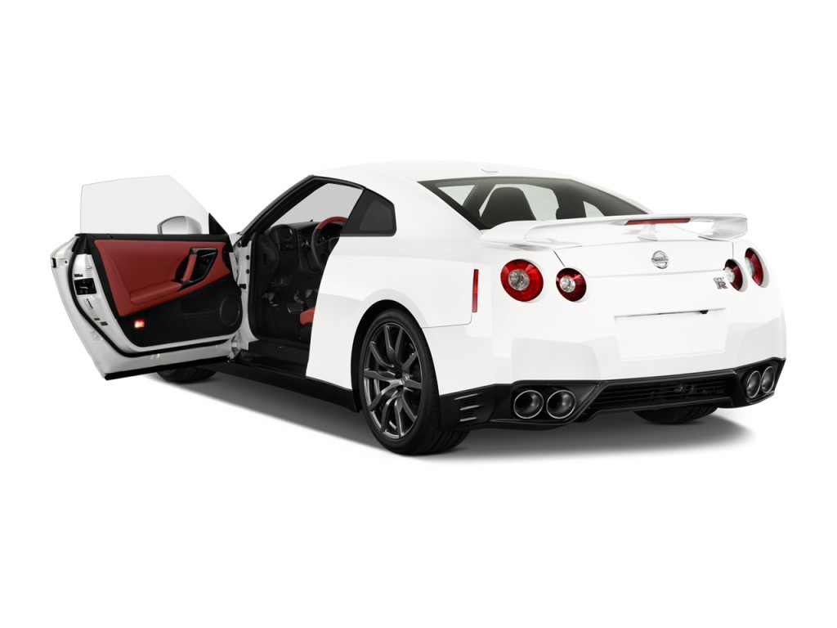
Schematic
FINGERPRINT
IOS
APP
PASSWORD
VOICE (Optional)
AUTHENTICATION

Slide 3
Schematic
FINGERPRINT
IOS
APP
PASSWORD
VOICE
AUTHENTICATION

Slide 4
Schematic
FINGERPRINT
IOS
APP
PASSWORD
VOICE
AUTHENTICATION
FRDM-K64

Slide 5
Schematic
FINGERPRINT
IOS
APP
PASSWORD
VOICE (Optional)
AUTHENTICATION

Slide 6
Technology
iOS APP — Provide a World-wide User-friendly Platform
Touch ID — The Most Secure and Handy way to Authentic Identity
Voice Recognize — Spare for Authentication and also Very Secure
Google Cloud Service — Low-cost, Powerful, Cloud Technology
Freedom FRDM-K64 Board — Low power consume, Perfect for IoT

Slide 7
The course covers
Authentication - Fingerprint - Voice
Connectivity - Ethernet - 802.11 - TCP/IP
API - Fingerprint - Google Cloud APIs
IoT
FRDM-K64 Board

Slide 8
Scheduling
iOS APP Prototype — Done by April 10th - Basic App, Passwaord Part Works — March 27th - Touch ID — April 3rd - Voice Recognize — April 10th
Google Cloud Service — Done by April 24th - Connect iOS APP to Google Cloud Service — April 17th - Connect Google Cloud Service to Freedom Board — April 24th
Project Done — May 1st

Slide 9
Future
Add Sensors to Freedom Board to Monitor Car Condition, Such as Stolen, Damage Fuel Volume and etc.
Use Smartphone to Control Garage Door, House Front Door and etc.
Use Smartphone to Manage or Get Access to Some Important Places

Slide 10
Thank you
Alex

